Slide 1

Hotel Management
System
Business Data Management Project
Submitted by Group 8,
1) Vinit Vasant Bhanushali
2)Anukrati Vaishnav
3)Jatin Thakkar
4)Monjil Mehta

Slide 2
Abstract
This project’s objective is to help the customer with their hotel reservations and helping the hotel with their regular tasks, which includes maintaining a database that stores customer information and services provided from all the different branches.
To survive in a competitive market, a hotel must have at least two things:
Have an online presence that facilitates
the reservation process for visitors.
Provide exceptional customer service to help the
customers with their queries/issues.

Slide 3
Objectives
The main objective is to create a centralized system for a chain of hotels.
Centralized System contains all the rates of each hotel room depending on whether it is peak season/offseason.
Customer must pay the bill during check-out for all the services used.
Customer can make reservations and pay before check-in. Cancellation charges will be applied if not canceled before check-in time.
A single customer can have multiple reservations in a single booking. customers can check out whenever they want to, but extending their stay is subject to availability.
Customers can update their reservations before checkin.

Slide 4
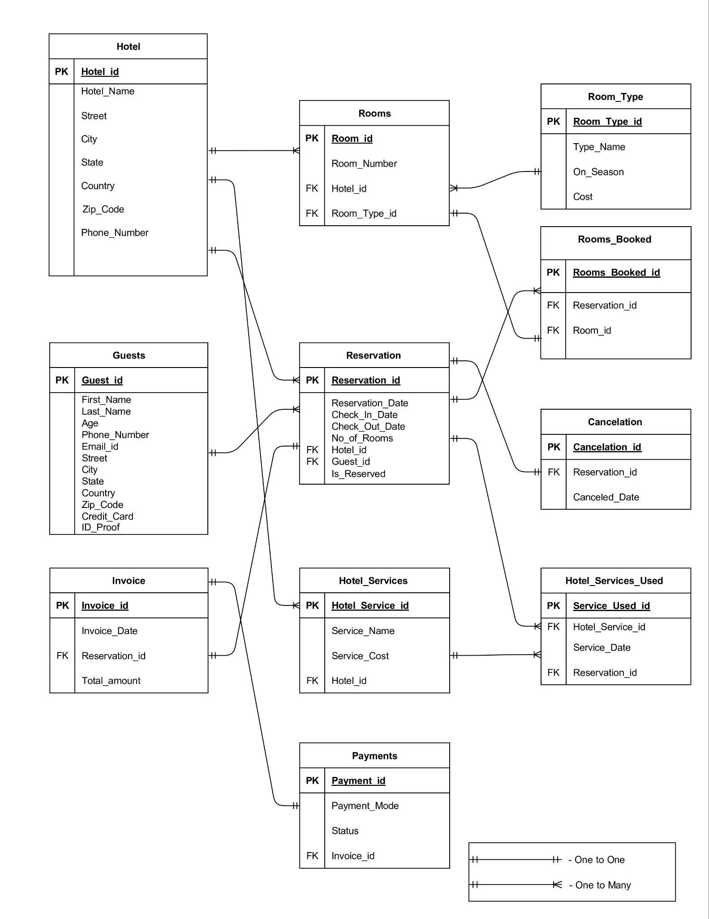
ER Diagram

Slide 5
ER Description
Hotel has one-to-many relationship with Room. This means that a hotel can have many rooms, but a room can only belong to one hotel. (Hotel_id)
Room Type has one-to-many relationship with Room. This means that a room type can be associated with many rooms, but a room can only have one room type. (Room_type_id)
Guest has one-to-many relationship with Reservation. This means that a guest can make many reservations, but a reservation can only be made by one guest. (Guest_id)
Reservation has one-to-many relationship with Rooms_booked. This means that a reservation can be made for many rooms, but a room can only be included in one reservation. (Reservation_id)
Reservation has one-to-one relationship with Cancellation. This means that a reservation can have at most one cancellation, and a cancellation can only be associated with one reservation. (Reservation_id)
Reservation has one-to-one relationship with Invoice. This means that a reservation can have at most one invoice, and an invoice can only be issued for one reservation. (Reservation_id)
Reservation has one-to-many relationship with Hotel_services_used. This means that a reservation can have many service uses, but a service use can only be associated with one reservation. (Reservation_id)

Slide 6
ER Description
Hotel_service has one-to-many relationship with Hotel_service_used. This means that a hotel service can be used many times by guests, but a service use can only be associated with one hotel service. (Hotel_service_id)
Payment has one to-one-relationship with Invoice. This means a single payment is used for a single invoice. (Invoice_id)
Hotel has one-to-many relationship with Hotel_services_used. This means one hotel has many hotel services for the guests. (Hotel_id)
Hotel has one-to-many relationship with Reservation. This means that single hotel can have multiple reservations. (Hotel_id)

Slide 7
SQL CODES
We have created the database named “A” and created different tables like Hotel, Guest, Room_Type, Rooms, Hotel_Services, Reservation (which has a computed column based on a function which calculates number of days stayed using the check in and checkout dates), Cancelation, Rooms_Booked, Hotel_Services_Used, Invoice, Payments. These tables has many different attributes as per hotel’s requirement.

Slide 8
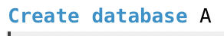
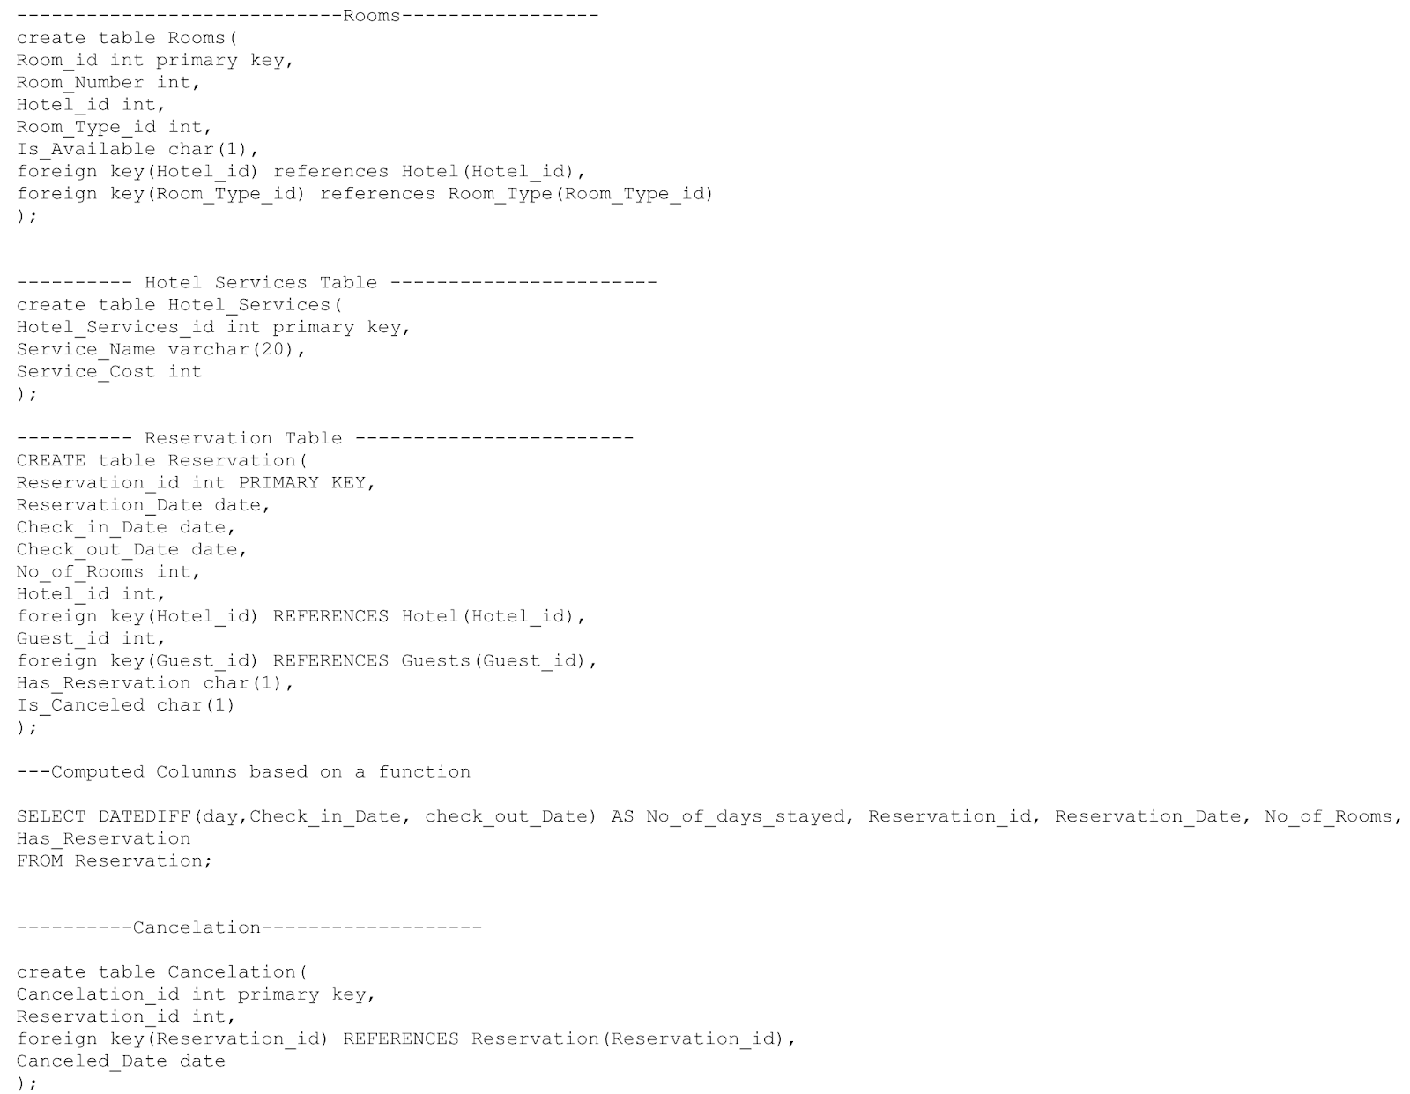
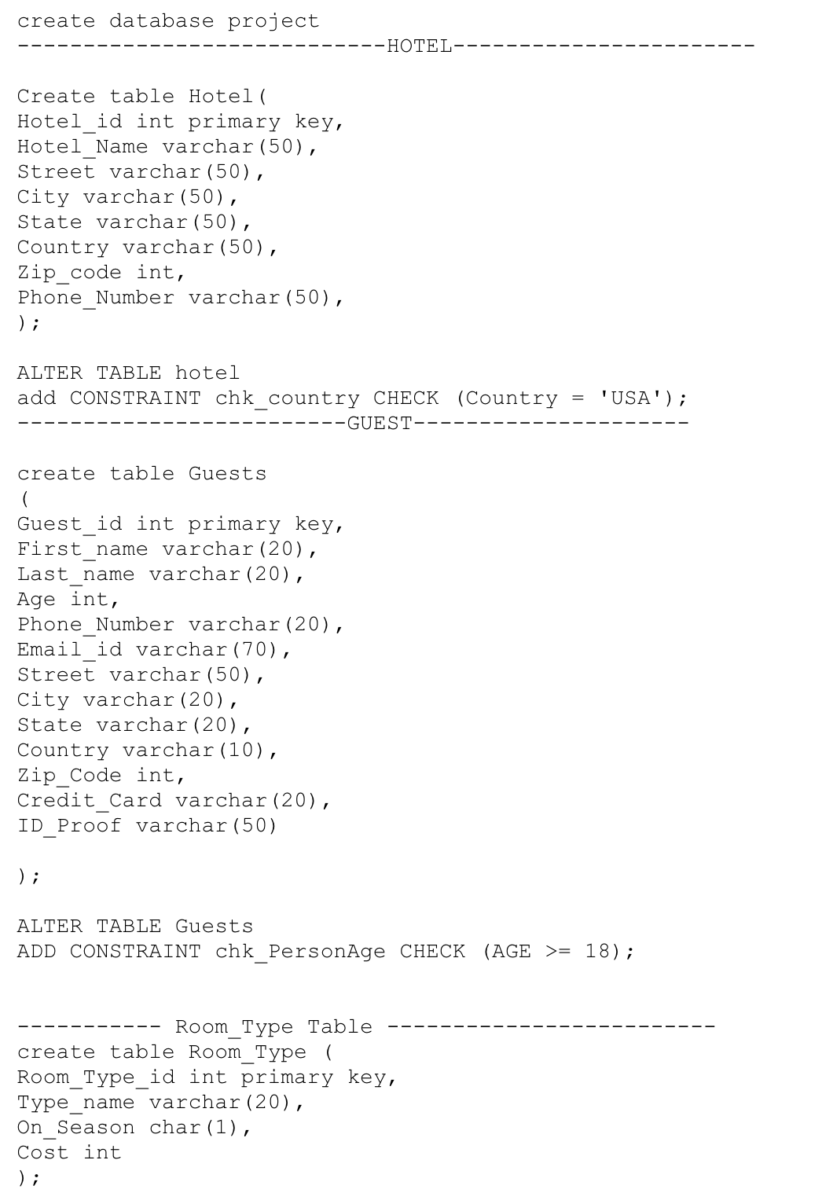
DDLs

Slide 9
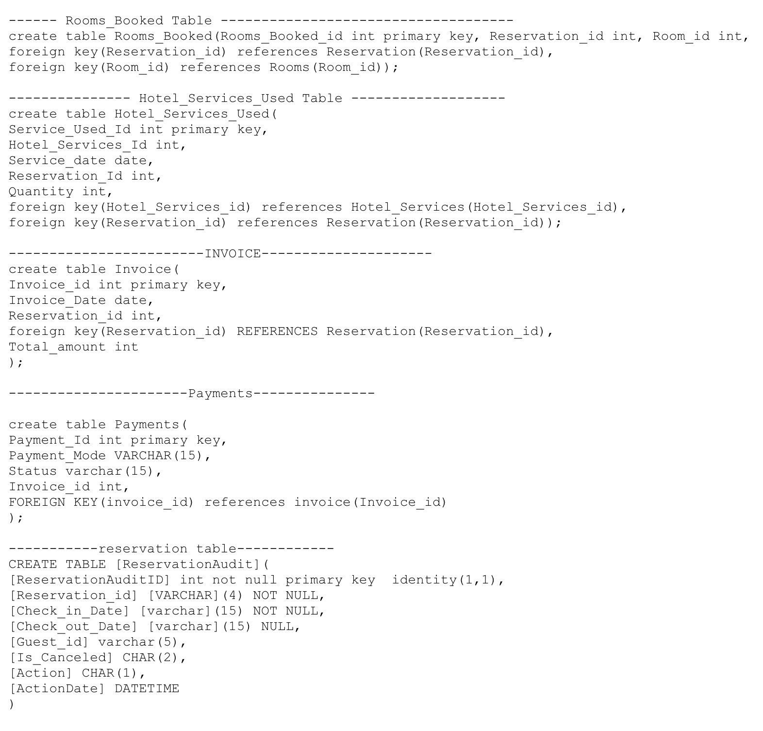
DDLs

Slide 10
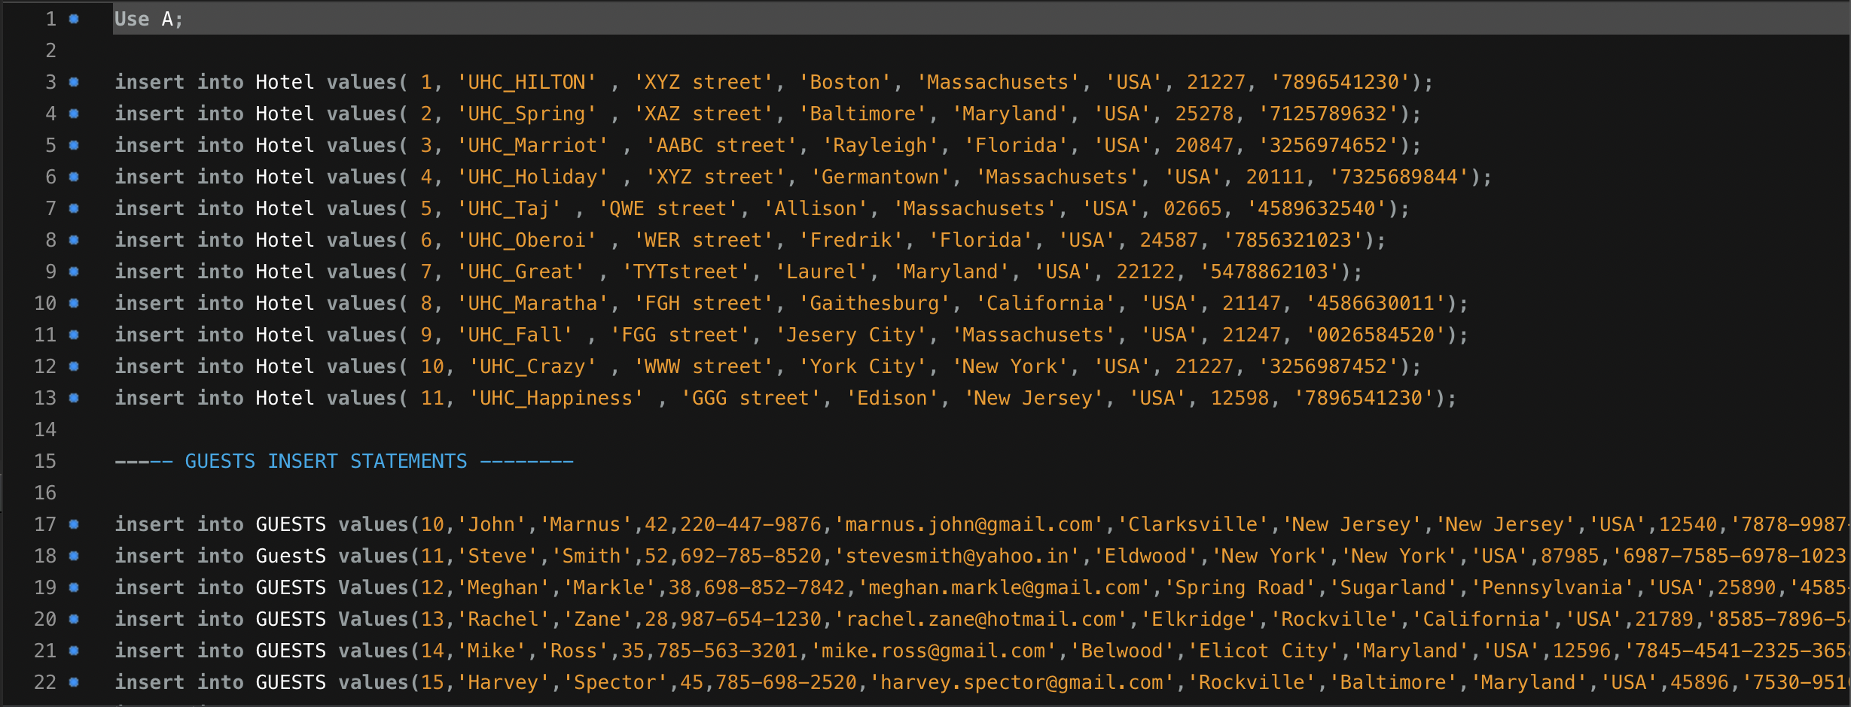
Dataset

Slide 11
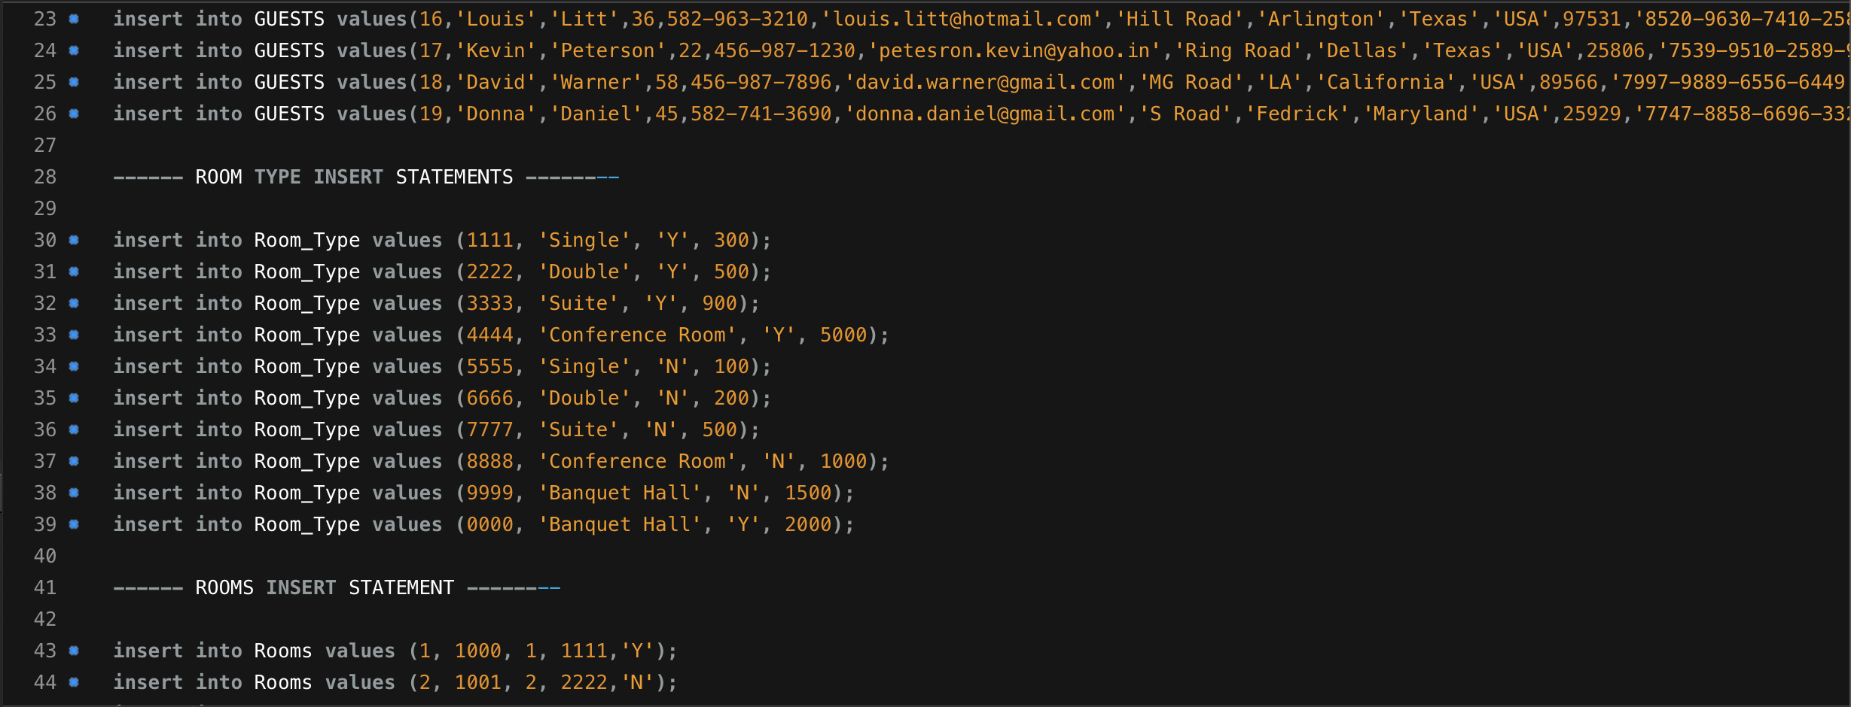
Dataset

Slide 12
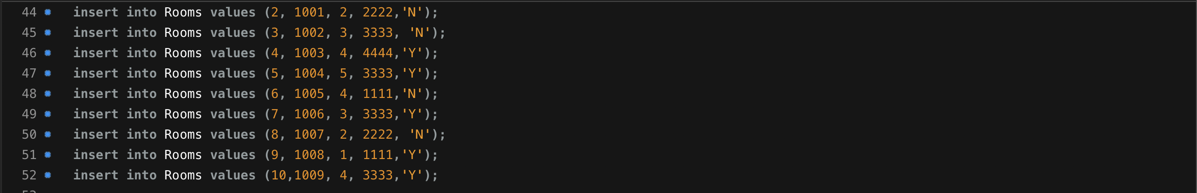
Dataset

Slide 13
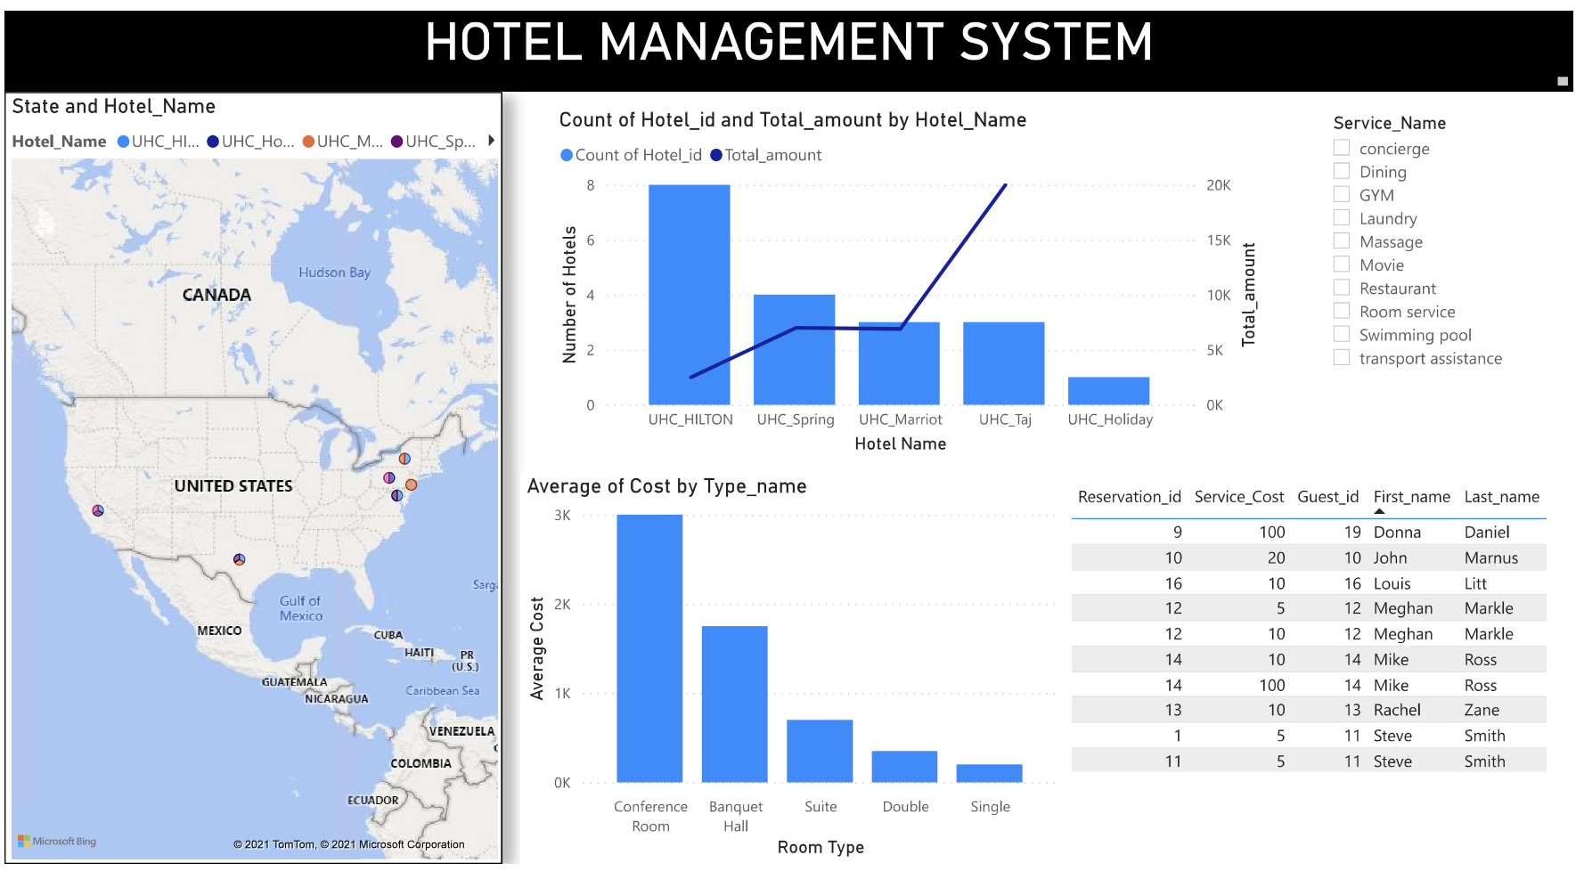
DASHBOARD

Slide 14
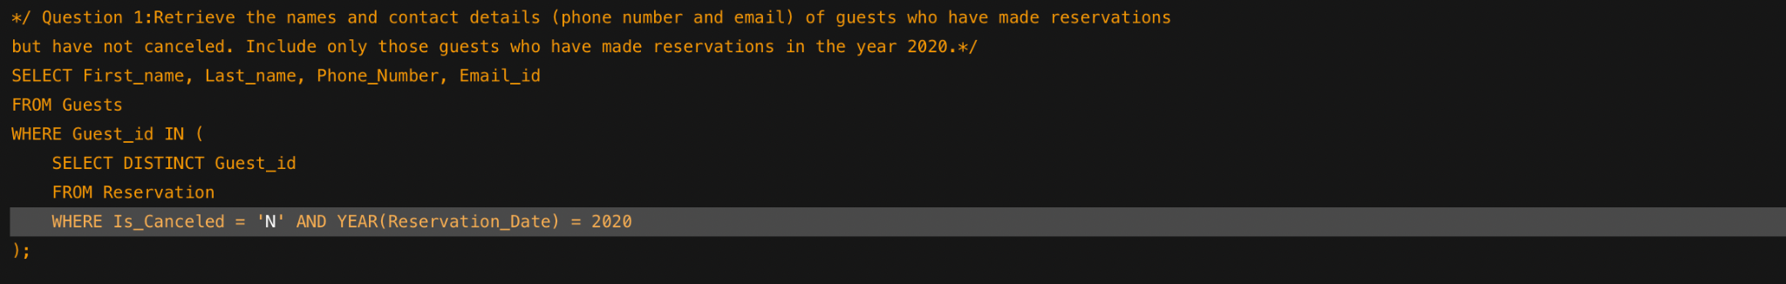
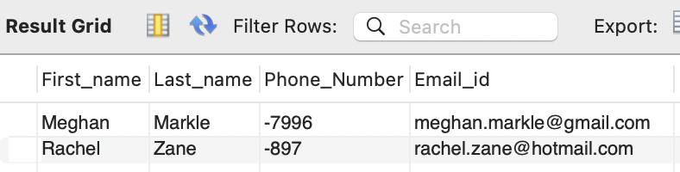
SQL Questions

Slide 15
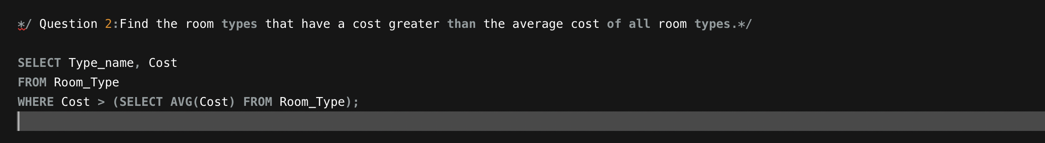
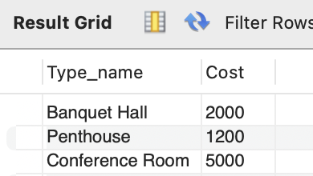
SQL Questions

Slide 16
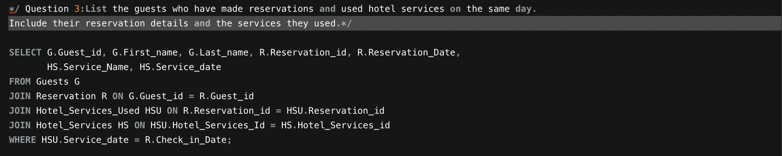
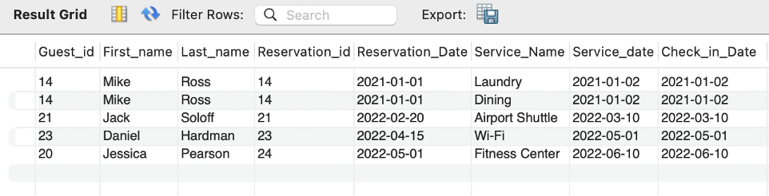
SQL Questions

Slide 17
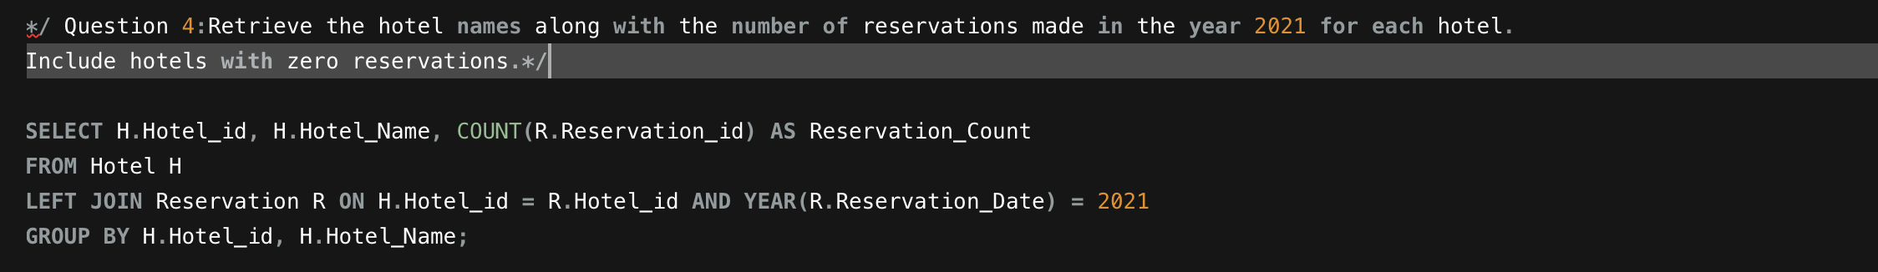
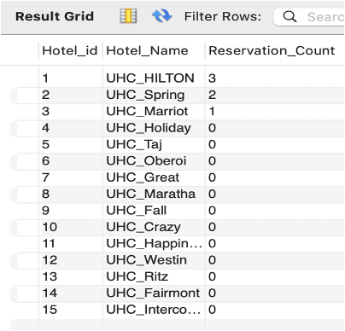
SQL Questions

Slide 18
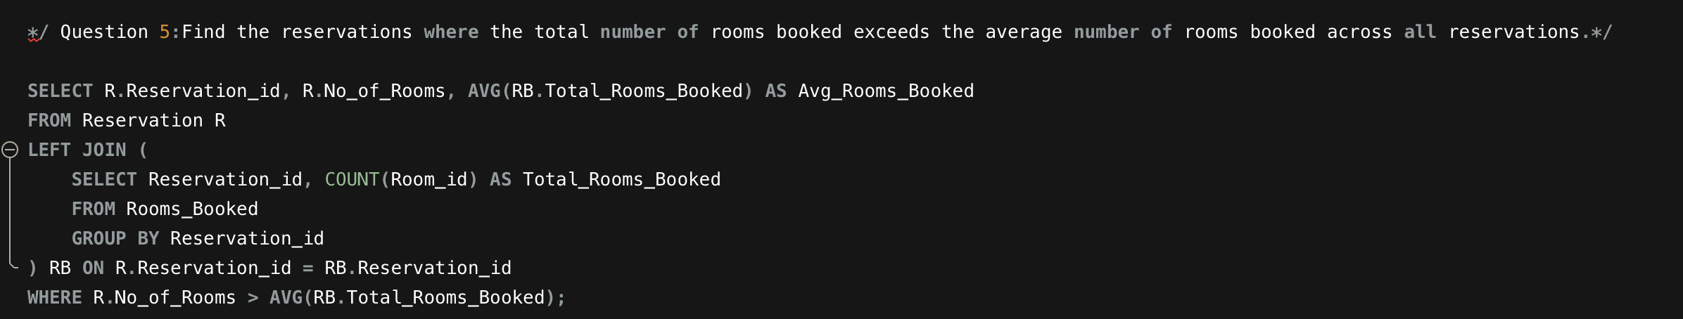
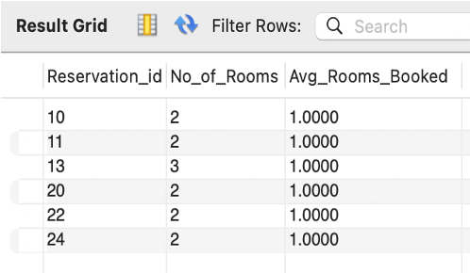
SQL Questions

Slide 19
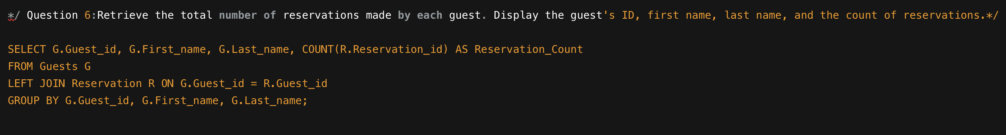
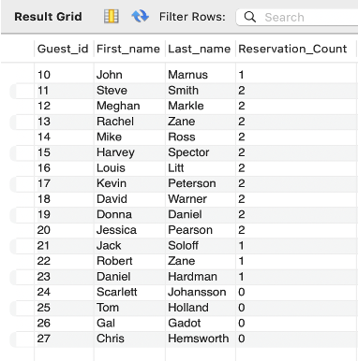
SQL Questions

Slide 20
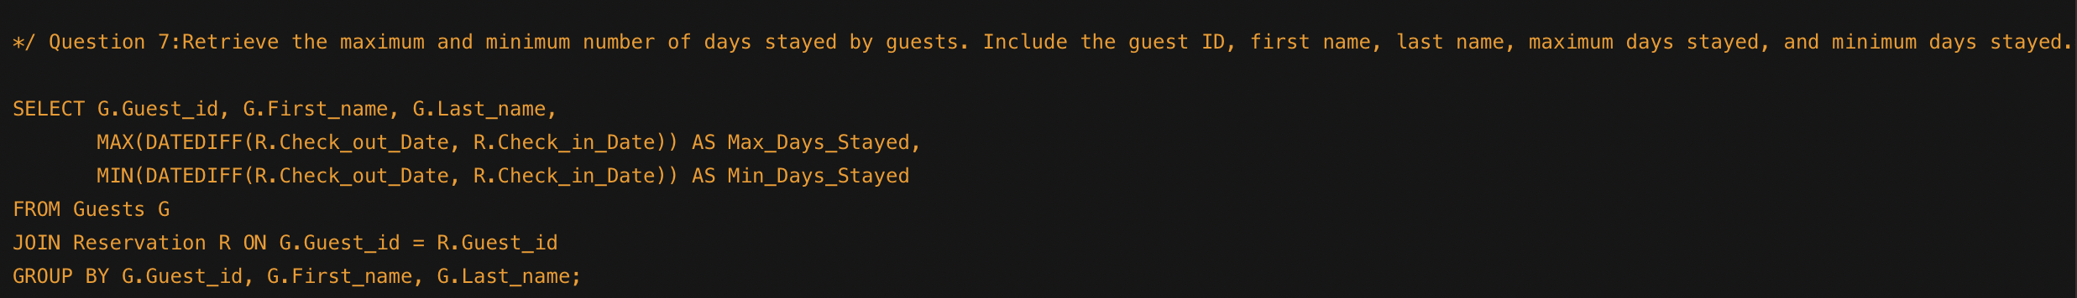
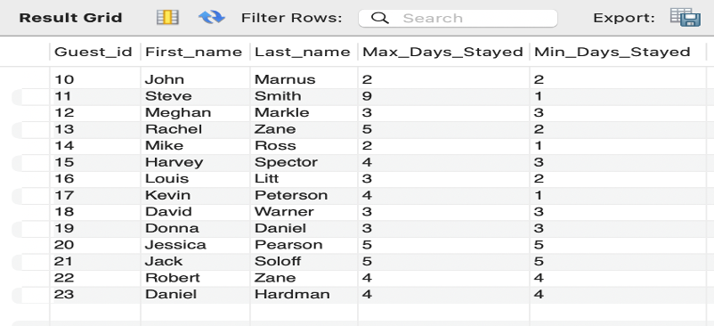
SQL Questions

Slide 21
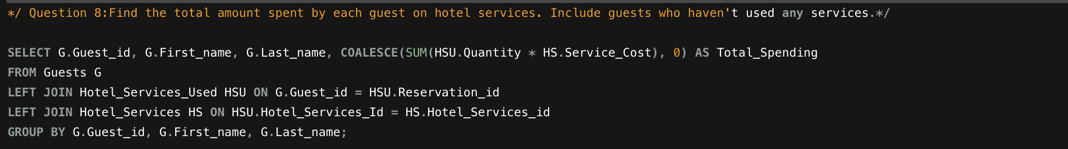
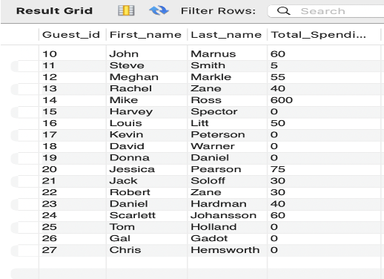
SQL Questions

Slide 22
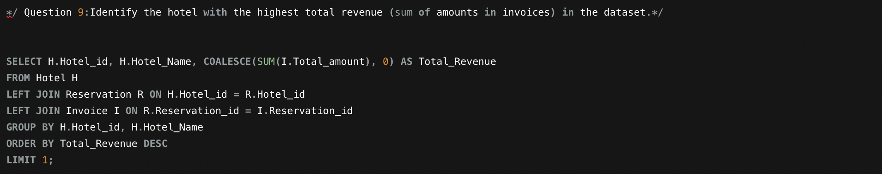
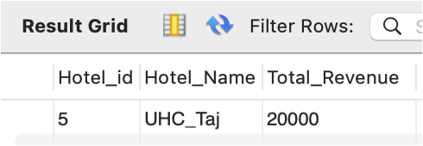
SQL Questions

Slide 23
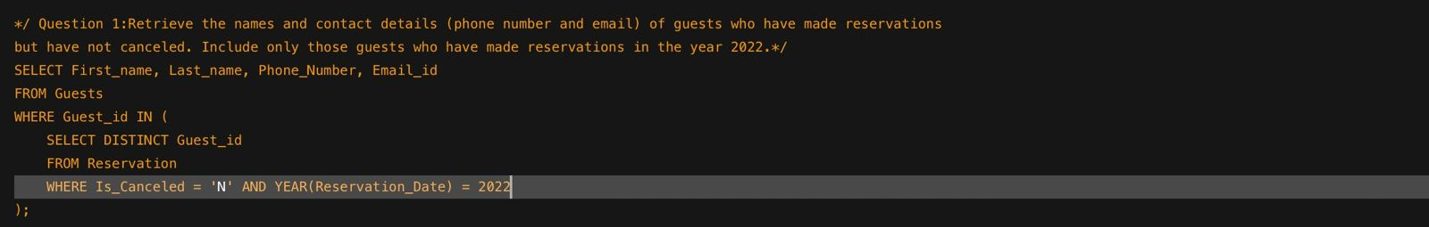
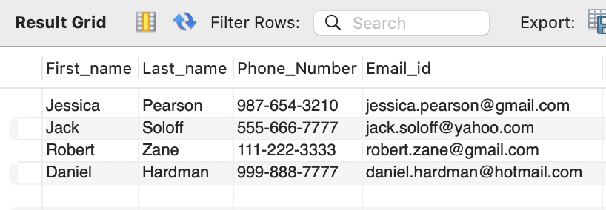
SQL Questions

Slide 24
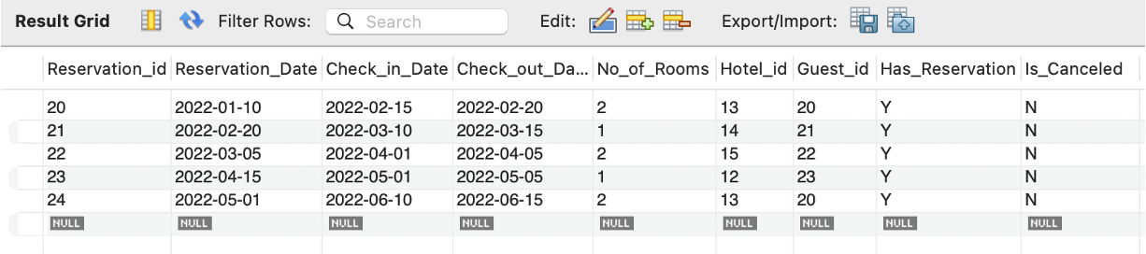
SQL Questions

Slide 25
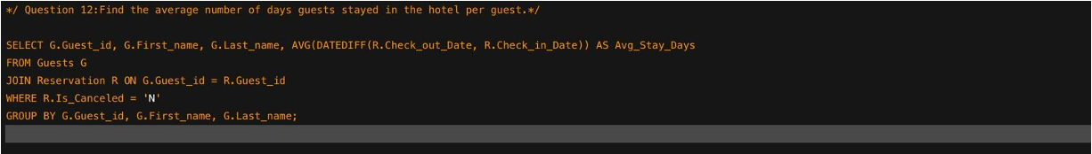
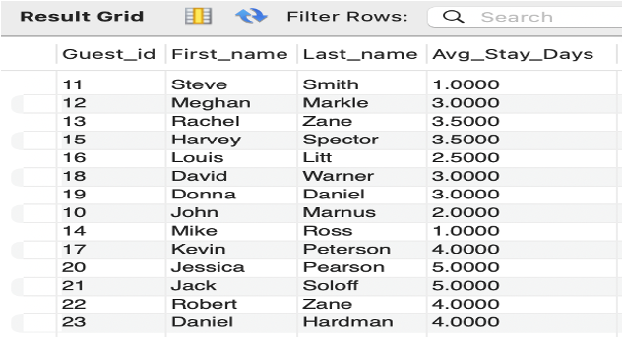
SQL Questions

Slide 26
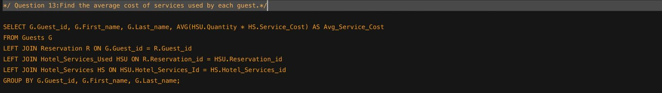
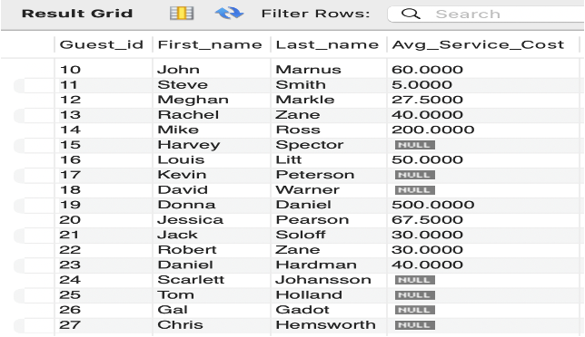
SQL Questions

Slide 27
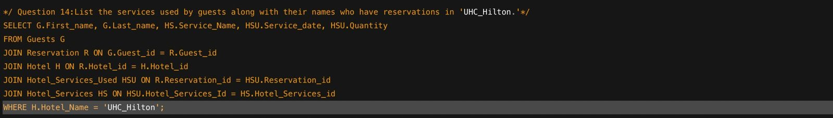
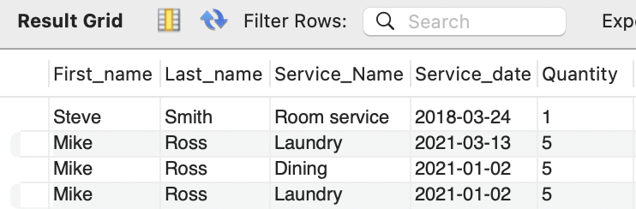
SQL Questions

Slide 28
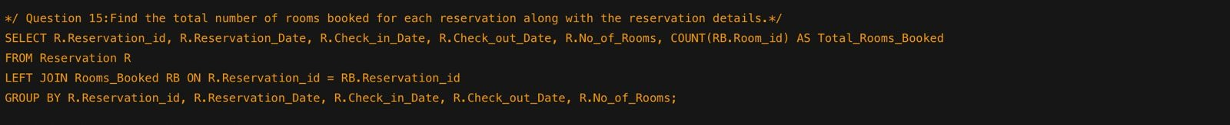
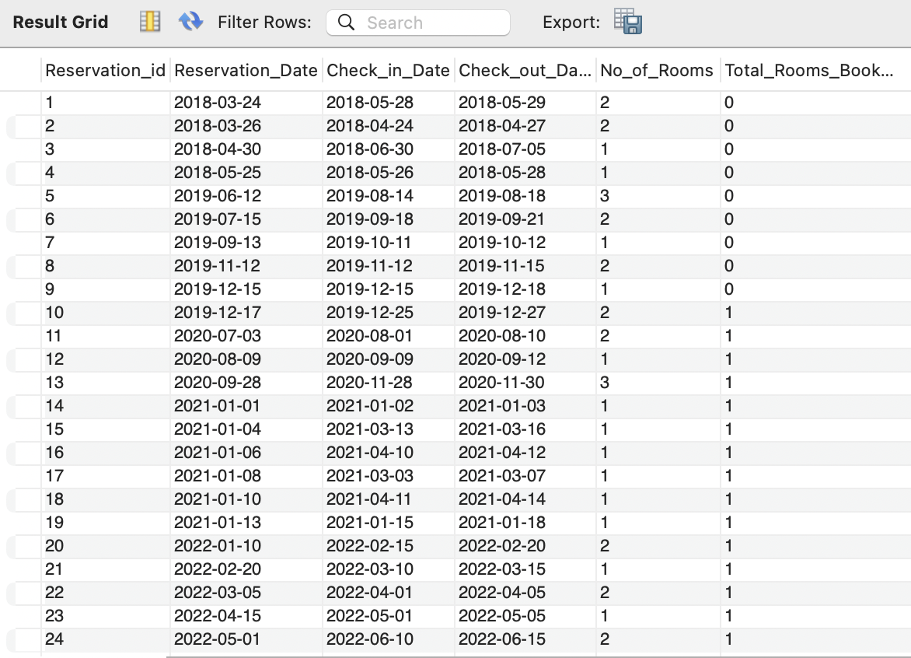
SQL Questions

Slide 29

This Photo by Unknown Author is licensed under CC BY-NC

